Slide 1

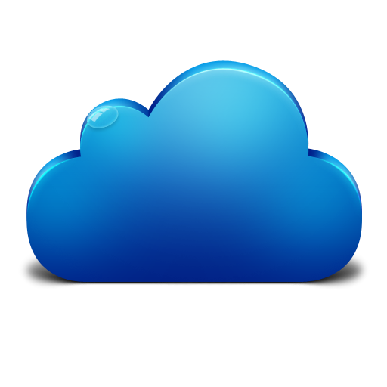
EMC Underground: MetroLabs
MetroLabs

Slide 2
Goal
The goal of this series of labs is to provide a hands on experience in developing a Continuous Integration/Delivery pipeline to deploy an apache web server with content to serve up through the web server.
The tools used this lab series will be:
Github
Jenkins
Puppet
Docker
VirtualBox

Slide 3
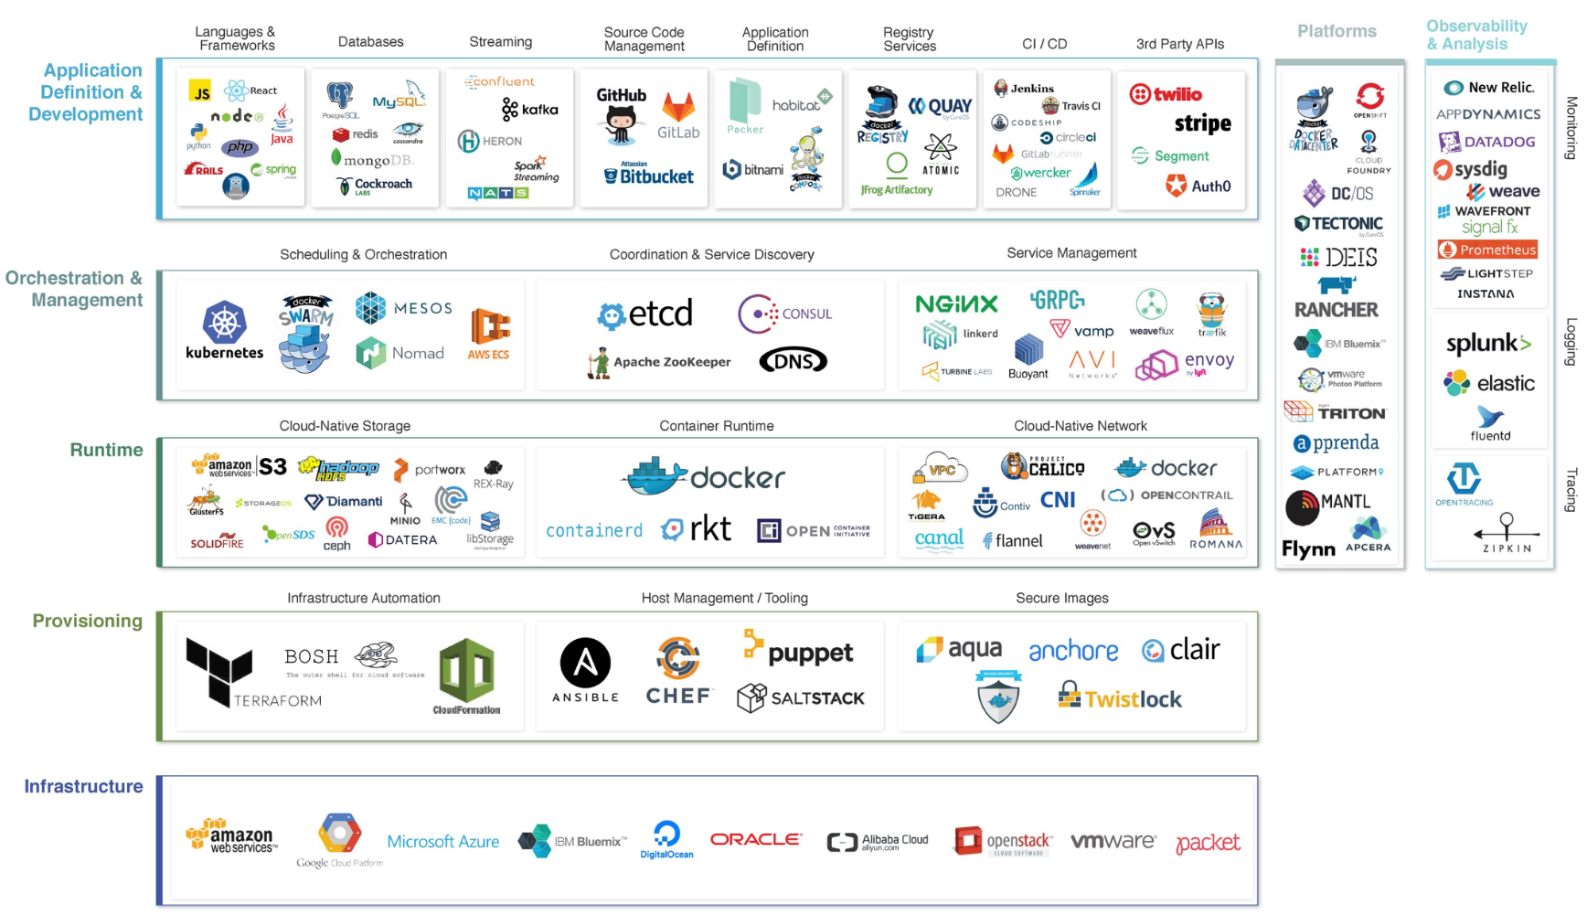
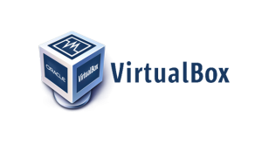
THE CLOUD NATIVE LANDSCAPE
*From Cloud Native Computing Foundation (CNCF)

Slide 4

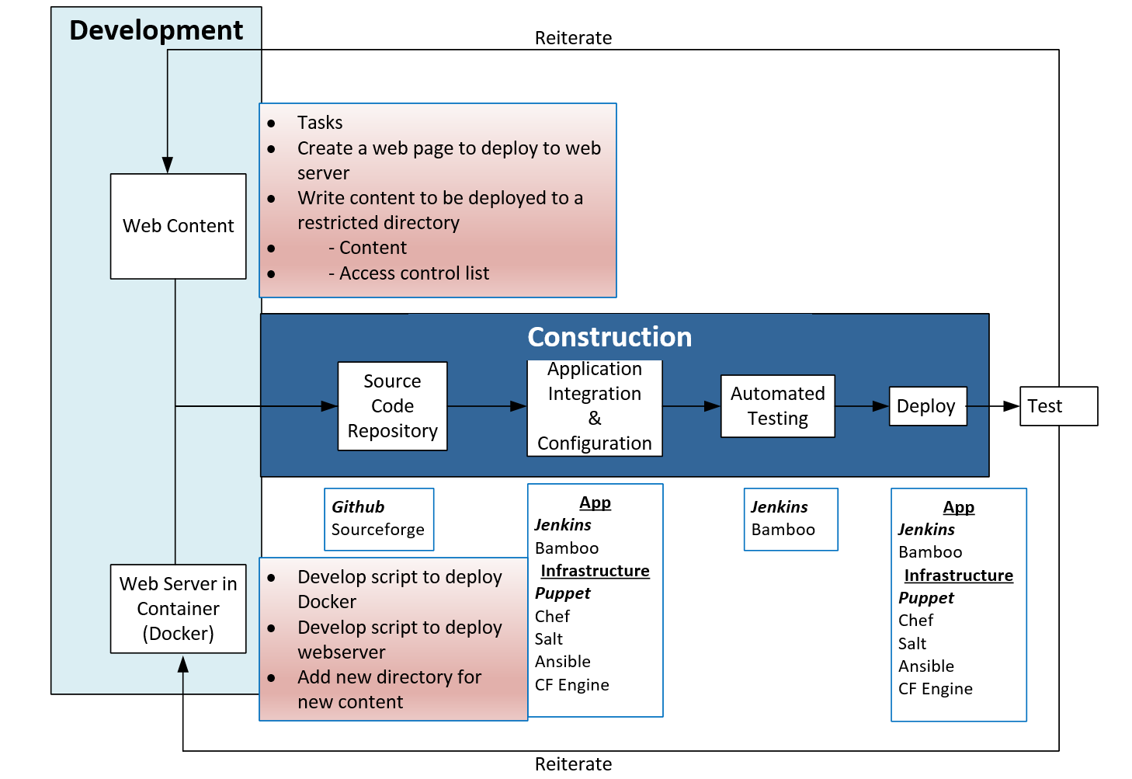

Slide 5
Review of First Session (9/29/2017)
Group Goals, Feedback, Meeting Cadence
Application Development evolution
Cloud Native Development Landscape
DevOps
Agile
Sprints / Scrums
CI/CD

Slide 6
First Homework Assignment
Download VirutalBox and Ubuntu 16.04 verison
Install VirtualBox & VirtualBox Extension Pack
Create 2 Virtual Machines
Puppet Master (This will be the VM supporting Puppet and Jenkins Server)
Configure VirtualBox
2GB RAM
1 vCPU
15GB HDD
Install Ubuntu 16.04
Puppet Client (This VM is where the container will be deployed)
Configure VirtualBox
2GB RAM
1 vCPU
15GB HDD
Install Ubuntu 16.04
Thoughts?
Challenges?
Notes:
Struggles:
What did you do when there was an issue?

Slide 7
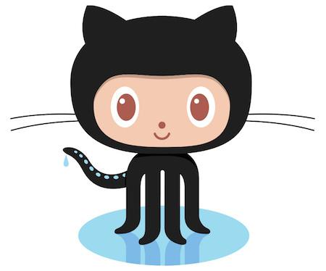

Communication is Key in DevOps Culture
DevOps requires communication and collaboration
DevOps values these skills as much as technical skill set
DevOps requires the breakdown of traditional silos
How are companies achieving this?
Scrum
Slack
Trello
Github
Notes:
Trello – Kanban
National / Global teams are key users of these tools

Slide 8
Slack for MetroLabs
Are you signed up yet?
nynjentpresales.slack.com
Exploration

Slide 9
Git & Github

Slide 10
Git and Github
Git is the distributed version control system. Git is responsible for keeping track of changes to content (usually source code files), and it provides mechanisms for sharing that content with others.
GitHub is a company that provides Git repository hosting
Git is a version control system; think of it as a series of snapshots (commits) of your code. You see a path of these snapshots, in which order they where created. You can make branches to experiment and come back to snapshots you took.
GitHub, is a web-page on which you can publish your Git repositories and collaborate with other people

Slide 11
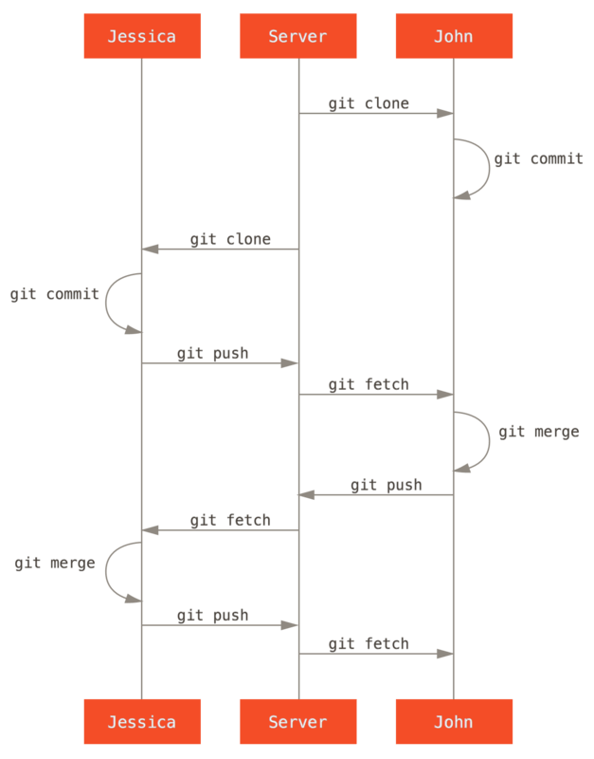
Version Control

Slide 12
Puppet

Slide 13
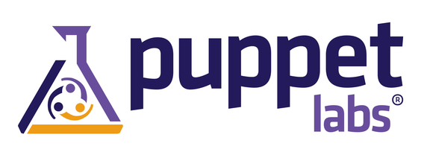
What is Puppet
Puppet is a open-source software configuration management tool
Developers like puppet because:
It is useful #1 when you have a helluva-lot of machines required to be configured in a similar form.
It is useful #2 when you have an infrastructure that requires the dynamic scaling-up and scaling-down of machines with a pre-determined (or at least metadata-calculated) configuration.
It is useful #3 to have control over all of your configured machines, so a centralized (master-server or repo-based) change gets propagated to all automatically.

Slide 14
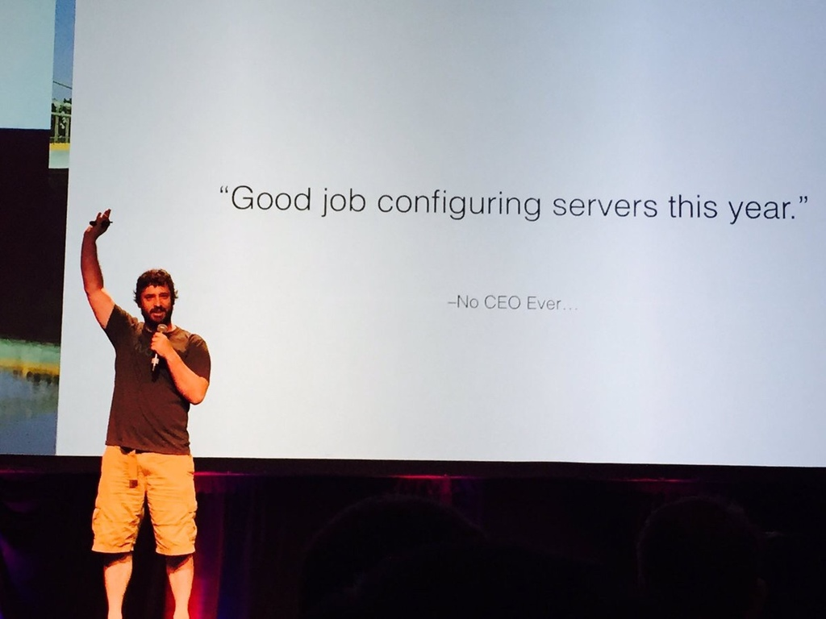

Slide 15
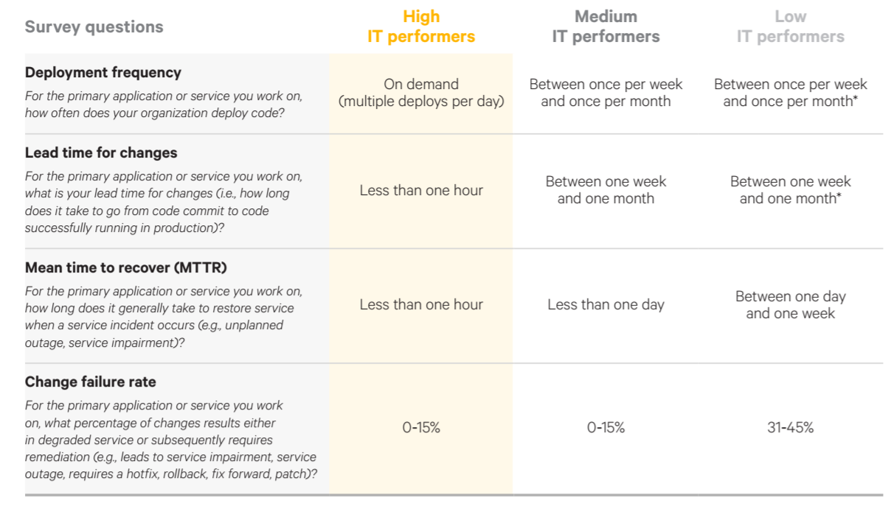
Why use automation tools?

Slide 16
Jenkins

Slide 17

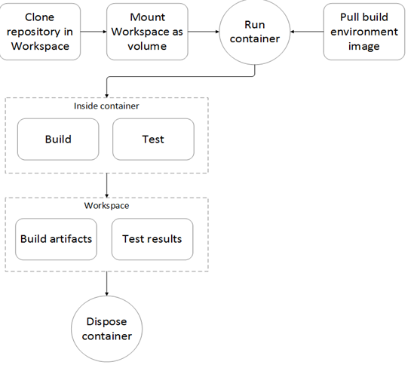
What is Jenkins?
Jenkins is an open source automation tool written in Java with plugins built for Continuous Integration purpose.
Used to build and test your software projects continuously
Making it easier for developers to integrate changes to the project,
Making it easier for users to obtain a fresh build.
Allows you to continuously deliver your software by integrating with a large number of testing and deployment technologies.
Organizations can accelerate the software development process through automation.
Integrates development life-cycle processes of all kinds, including build, document, test, package, stage, deploy, static analysis and much more.
Example of workflow using Jenkins

Slide 18
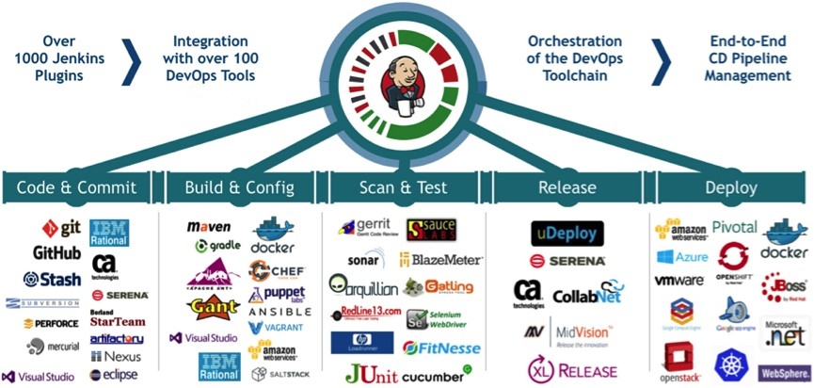
Plugins & Companies that partner with Jenkins
Jenkins achieves Continuous Integration with the help of plugins. Plugins allows the integration of Various DevOps stages. If you want to integrate a particular tool, you need to install the plugins for that tool. For example: Git, Maven 2 project, Amazon EC2, HTML publisher etc.

Slide 19
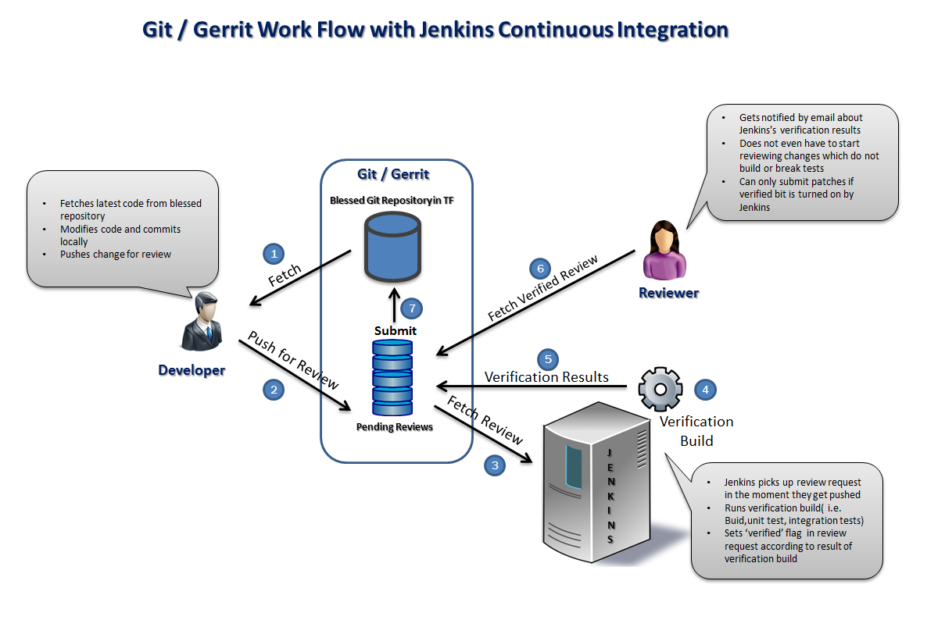

Slide 20
Questions?

Slide 21
Thank You

